Slide 1
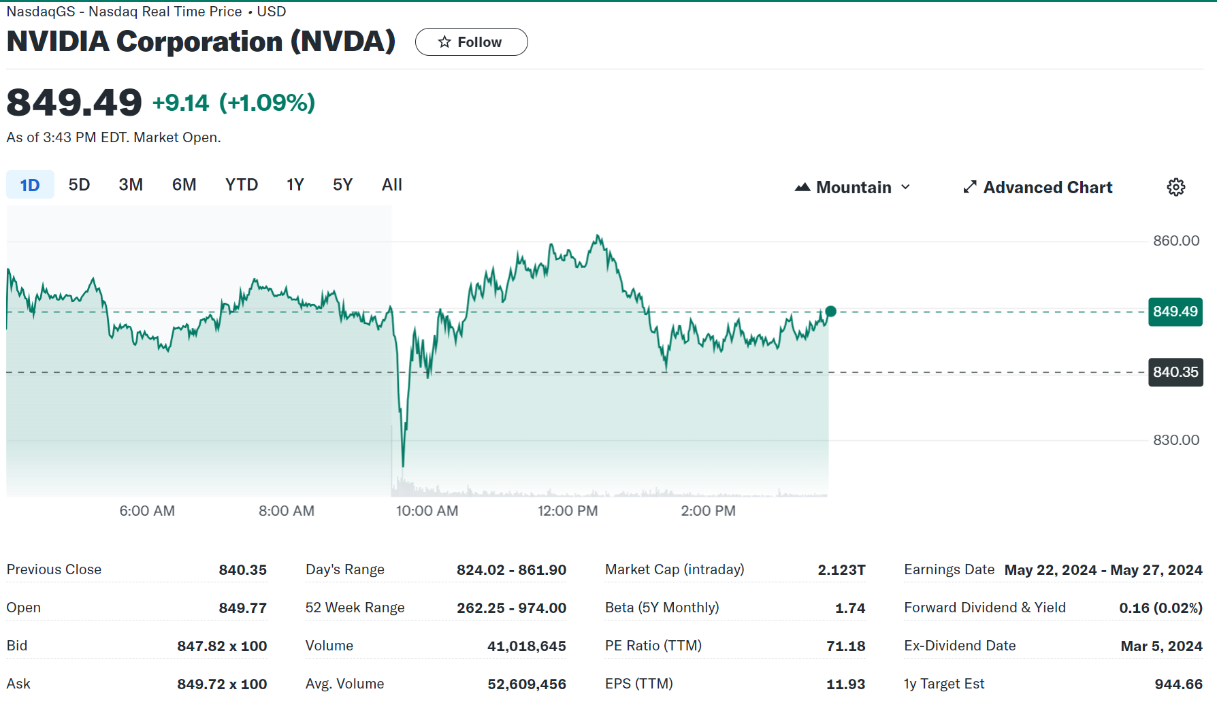
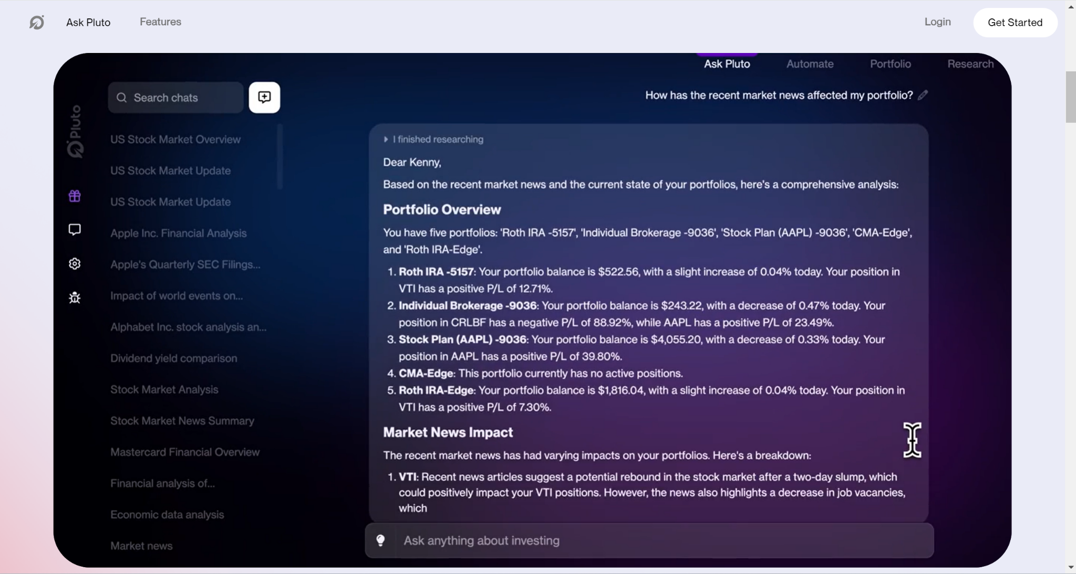
Stock Stock

Slide 2

Stock Stock
Coz sometimes two stocks are better than one
Our Team
Benjamin Tan, Nien-Ting Lee,
Shashvat Joshi, Siyuan Zhu,
Wenxuan Wu, Zhiying LI

Slide 3
Introduction & Background
01
Background
In today’s digital age, Big Data has revolutionized the way financial markets operate, enabling precise market trend analysis, risk management, and investment decision-making. Our project, “Stock Stock”, harnesses this power to develop a cutting-edge financial analysis system that leverages vast data to provide deep market insights.
Definition of Analytics problem
Traditional analytics tools often struggle to handle and interpret the diverse data types found in finance. Our goal is to seamlessly integrate and analyze both structured and unstructured data to offer valuable stock insights.
02

Slide 4
Data Sources & Procurement
01
Data Approach
The data for each stock are acquired from written a Python script from the website Financial Modelling Prep API (https://site.financialmodelingprep.com/). However, the latest stock data is updated on 2024/3/12.
02
Data Description
There are 2 types of data in our database: structured and unstructured data. The unstructured data is primarily the earning call script data. The structured data are stored in the Postgre database holding diverse financial information, including cashflow_statement, symbol_list, historical_price, revenue_product_segment, income_statement, balance_sheet, insider_trading_statistic, revenue_geo_segment, company_profiles, financial_ratios, and insider_trading. Each table is interconnected and designed to capture a specific subset of data, from company financials and stock prices to insider transactions and revenue segmentation.

Slide 5
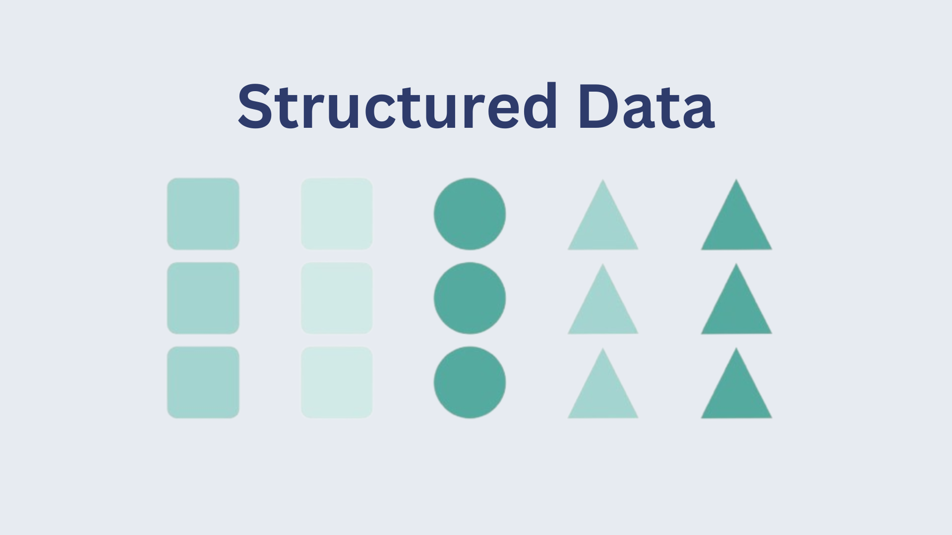

Database Design for
Hybrid ETL - ELT
01. Structured Data using PostgreSQL and flask
(historical prices, financial ratios data…)
02. Unstructured data using MongoDB and LLM
(earnings call scripts data)
Since one of our goals is to create dashboards about historical stock price trends and financial situations, we use Python to extract and transform the data, and then store related structured data with star schema into postgreSQL.
Since we also want to use sentiment analysis to analyze the news about the stocks by large language model, we extract and load earnings call text data into mongoDB to make it more efficient and then use embedding model to transfer data into vectors.

Slide 6
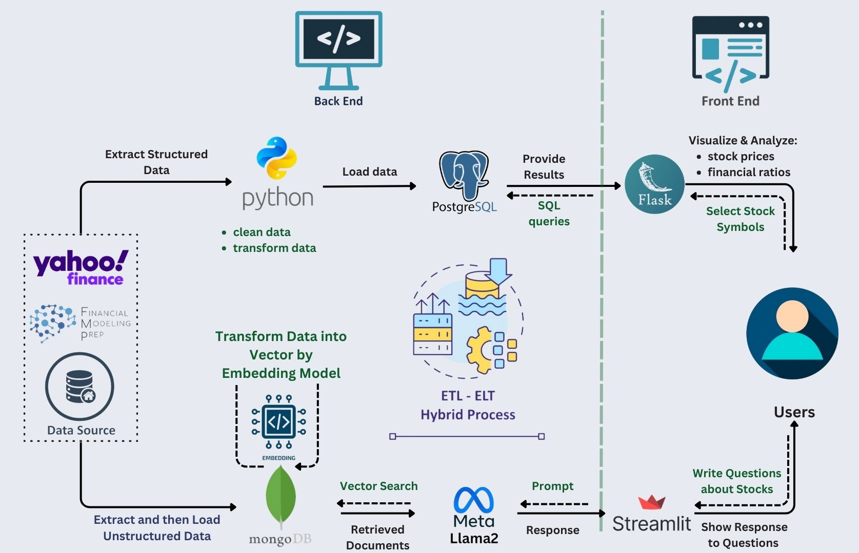
Data Extraction Pipeline
Stock price and financial data - ETL
extract structured data from our financial data resources
clean and transform the data by using Python
load data into PostgreSQL based on schema
write SQL queries to get stock information that users need
present historical prices graphs and financial ratios tables via flask
Earnings call scripts data - ELT
extract earnings call text data from financial resources
load the data into MongoDB
transform text data into vector by embedding model
implement sentiment analysis via large language model
provide text-verson stock insights that users ask for

Slide 7

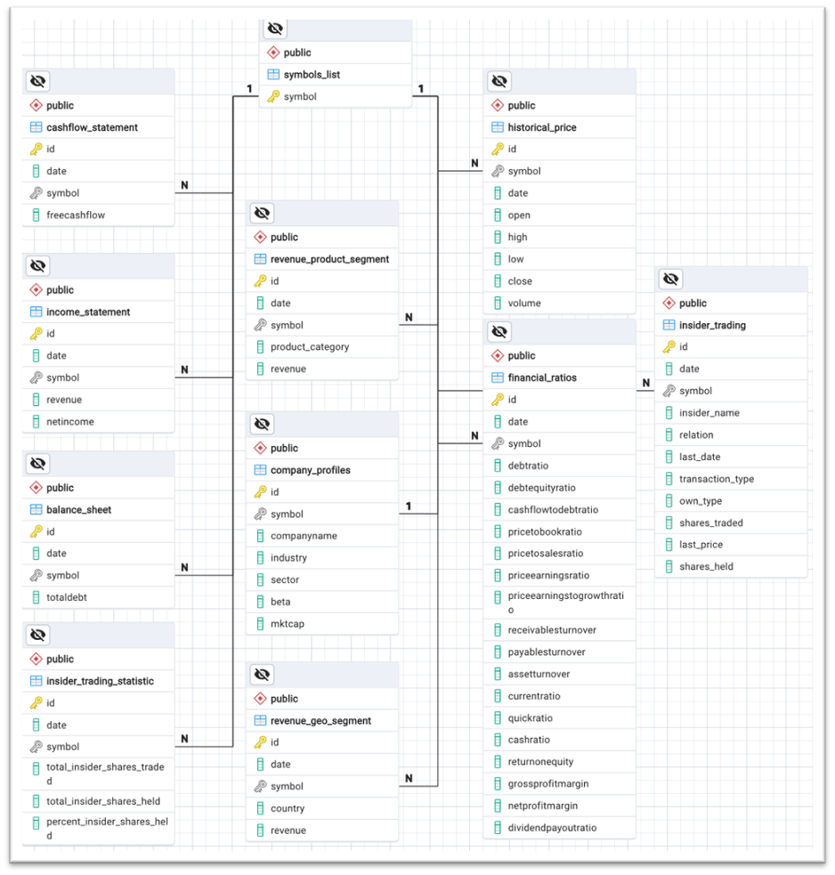

Schema Design
01
Modular Design.
Each block (module) represents a specific category of data, and can be updated or modified without impacting other parts of the database significantly.
02
Primary Key & Foreign Key.
The field of symbol is not only the primary key in the table symbols_list but also the foreign key referred by all other tables. For all the tables other than the symbols_list, they take the field id as their own primary keys.
U N I G R A P H
03
1-N relationship.
The table symbols_list has 1-N relationships with all the remaining tables since a company has multiple records in other tables because of the various dates. Similarly, the 1-N relationship applies to company_profiles and other tables.
04
Principles.
Update on Cascade & Update on Delete
When a record in a parent table is updated/deleted, corresponding records in child tables are automatically updated accordingly.
Prevents orphan records without corresponding parent records, maintaining database integrity

Slide 8
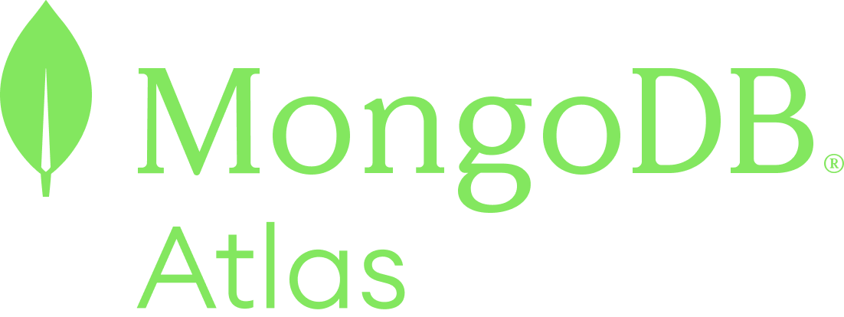
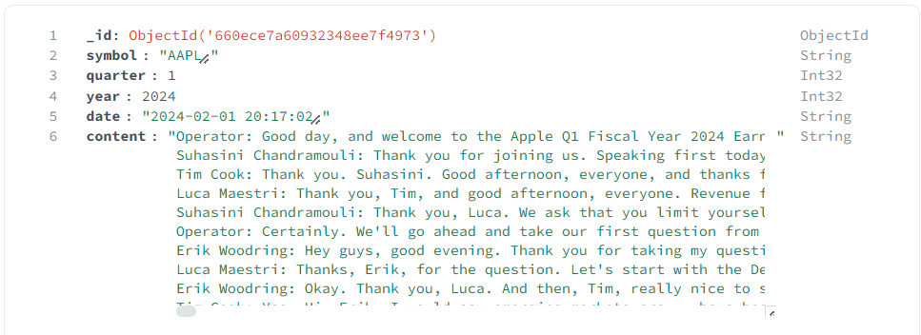
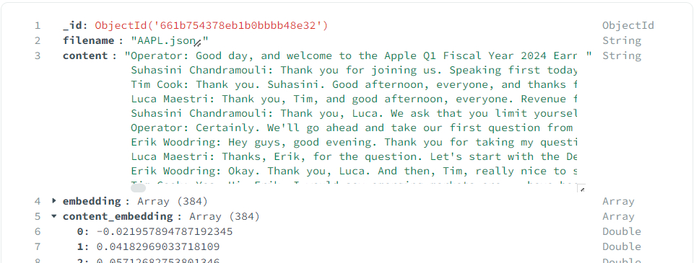
Retrieval Augmented Generation (RAG) with LLM
NVDA’s outlook? take the earning call into account
NVDA’s outlook?
[-0.0331…], [0.0632…]
RAG
01
Vector Embeddings for Text
Own Data from MongoDB
Context Prompt
Prompt
(with no Context)
Embedding model
(Sentence Transformer)
+
Large Language Model
Llama 2
Captures the semantic meaning of words and their relationships within a language.
Schema Design
Unstructured Text data
MongoDB Atlas Vector Search retrieves Contextual data fast
02
Earning Call data
[-0.0214…]
[0.08159…]
Vector Index Store
Allows for multifaceted searches based on semantic similarity and various metadata attributes
JSON file
(from API to MongoDB)
Type | Text Embedding Model | LLM
Model | sentence-transformers/all-MiniLM-L6-v2 | Llama 2
Purpose | Converting text into vector embeddings (maps sentences & paragraphs to a 384 dimensional dense vector space and can be used for tasks like clustering or semantic search.) | Understanding and generating natural language
Output | Length of array = number of dimensions • Dimensionality depends on model used • For example, the sentence transformer model, all-MiniLM-L6-v2 generates a vector with 384 dimensions | Text, answers, translations, code, etc.
03
Vector Index Search
Provides approaches to calculate vector similarity. These are also referred to as distance metrics.
Allows for multifaceted searches based on semantic similarity and various metadata attributes
Embedding model
MongoDB Schema
(for Vector Store)
Notes:
For MongoDB Atlas, and the retrieval Augmented generation designed as a modular overlay to Llama2LLM architectures, allowing for flexibility in deployment and the ability to update or replace components independently as better models and techniques become available.
There are 2 MongoDB Schema designed.
One for the JSON files directly from the API
The other schema is designed for Vector Store where we store the unstructured text and text vector embeddings that is transformed for fast retrieval.
So how this work is:
User Prompt: The process begins with a user entering a query or a prompt that is processed by the embedding model that is used to convert the text into vector embedding. Which are numbers.
Next to retrieval information from our Knowledge Base:
a vector Index Search on MOngoDB Atlas is created for the vector representing the user's prompt is used to search a knowledge base that consists of pre-processed embeddings unstructured text data.
Remember frameworks 2? similarity metrics (like cosine similarity or Euclidean distance), the system identifies entries in the knowledge base whose embeddings are closest to the embedding of the prompt.
Together with the Context that we give our LLM to search for earning call related information, the retrieved knowledge is fed into our Llama2 LLM.
The Response Generation will not only addresses the user's initial query but does so with added depth and relevance, informed by the specific information retrieved and presented in the contextual prompt.

Slide 9







Scalability and Cost Implication
AWS S3
Monthly Cost: $1176.60
Details: 51,200 GB x 0.023 USD
Category: Storage
Spec: Storage 50 TB/month
AWS EC2
Monthly Cost: $120.60
Details: 2 instances x 0.0826 USD
Category: Server
Spec: vCPU6, Memory (GiB): 32, Compute Savings Plans (North Virginia region)
FMP License
Monthly Cost: $99
Details: 3,000 API Calls / Min, Websocket
Category: Bulk and Batch Delivery
01
Total
$17,761.16
Llama 2
Atlas
Monthly Cost: $9167.96
Details: $10.99/h x 955 h/month
Category: NoSQL Database
Spec: M260 | 2000 GB Storage | 128 vCPU | 512 GB RAM
02
03
AWS SM
Monthly Cost: $7,191.00
Details: 100 hr training x 0.23USD + 51,200GB x 0.14 USD (ML Storage)
Category: Machine Learning
Spec: Storage 50 TB/month

Slide 10
Data Governance and Regulations
Data governance in our project ensures that data management processes meet precise standards from acquisition to usage. We implement roles such as Data Stewards and Data Custodians to manage data quality and security throughout its lifecycle.
Data Quality Dimensions
We evaluate our data across multiple dimensions—accuracy, completeness, consistency, timeliness, and validity—to ensure it's suitable for making investment decisions.
Licensing & Policies
All open-source data utilized by our project is compliant with the Open Data Commons Attribution License (ODC-By) and the Open Database License (ODbL). Additionally, we subscribe to Financial Modeling Prep's API, paying $99 per month, ensuring all data retrieved is licensed appropriately for commercial use.
Creative Commons and Open Data
We use Creative Commons licenses for datasets not covered by ODbL, specifically CC BY-SA and CC BY-ND, to promote data sharing and innovation while protecting creator rights.
Intellectual Property and Rights
We ensure all proprietary data and technologies are protected under specific intellectual property laws and policies, safeguarding our innovations and the commercial interests of our clients.

Slide 11
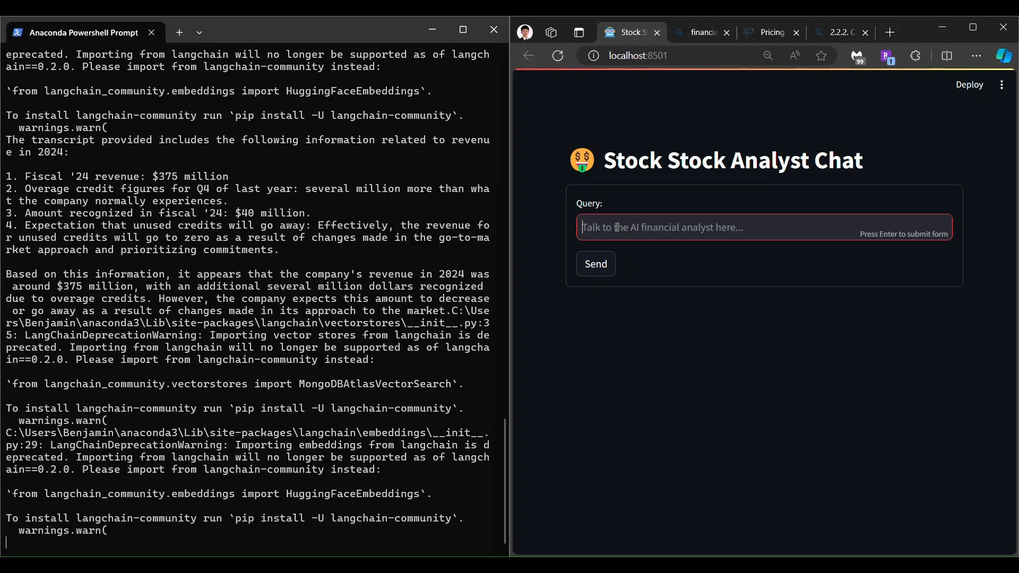

Slide 12

Thank you!!’
＼ʕ •ᴥ•ʔ／
Thank You !

